Slide 1


Slide 2


Slide 3
what’s new in
Elastic Stack V5
@medcl

Slide 4

About me
Medcl，曾勇（Zeng Yong）
Developer @ Elastic
Follow Elasticsearch since v0.5, 2010
Joined Elastic since September, 2015
Now in Beats team
@medcl
medcl@elastic.co
http://github.com/medcl
Based in Changsha, Hunan, China

Slide 5
What’s Elastic？
A distributed startup company，since 2012
HQ: Mountain View, CA AND Amsterdam, Netherlands
With employees in 30+ countries (and counting), spread across 18+ time zones, speaking over 30+ languages
We are working on Open Source projects!
(Luckily some of them are popular, eg:elasticsearch)
Offering support Subscription，X-pack，Cloud and Trainings
Find us on: https://github.com/elastic and https://www.elastic.co

Slide 6

听说过 “ELK” 么?
Notes:
/ə‘brivɪ’eʃən/ mascot

Slide 7


ELK is out，at least renamed！
我来也！
Beats & Packetbeat
ELKB? BELK? LKBE? BKEL?
Notes:
Last year, we brought the Packetbeat team on board, and Beats was born.
This open source platform for building lightweight data shippers for log files, infrastructure metrics, network packets, and more, makes it easier than ever to send data to Elasticsearch and Logstash.
While we love how many of you who have adopted the abbreviation ELK for our stack, with Beats, we just couldn't figure out how to make the "B" work with the E-L-K combination.

Slide 8
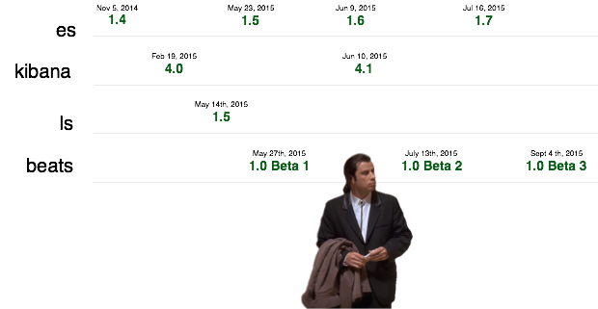
It’s complicated

Slide 9
It’s time to unite!

Slide 10

https://www.elastic.co/v5

Slide 11





The “Elastic Stack”
User
Interface
Extensions
Store, Index,
& Analyze
Ingest
Notes:
Brand new!

Slide 12
The “Elastic Stack”
User
Interface
Extensions
Store, Index,
& Analyze
Ingest
Notes:
Brand new!

Slide 13
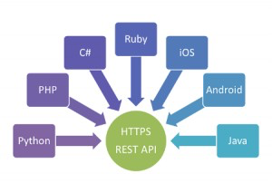

Elasticsearch is an open source, distributed, scalable, highly available, document-oriented, RESTful, full text search engine with real-time search and analytics capabilities
Thomson Reuters: “107 clusters ~1747 nodes” @Elastic{ON}16
https://speakerdeck.com/elastic/thomson-reuters-research-journalism-finance-and-elastic
Netflix：”~150 clusters totaling ~3,500 nodes hosting ~1.3 PB of data”
http://techblog.netflix.com/2016/02/evolution-of-netflix-data-pipeline.html?m=1
Real-time analytics
Time series data analytics
Logging analytics
Security analytics
Fraud detection
Prediction modeling
Recommendations
…
http://github.com/elastic/elasticsearch
Notes:
Do you love open source? 30MB

Slide 14
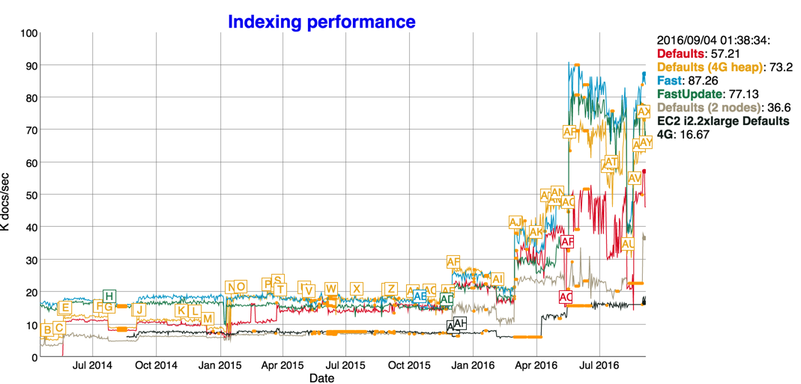
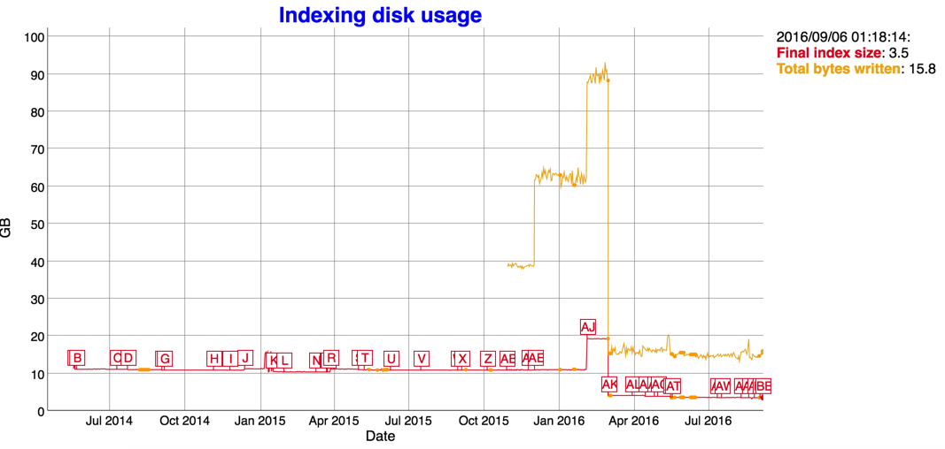
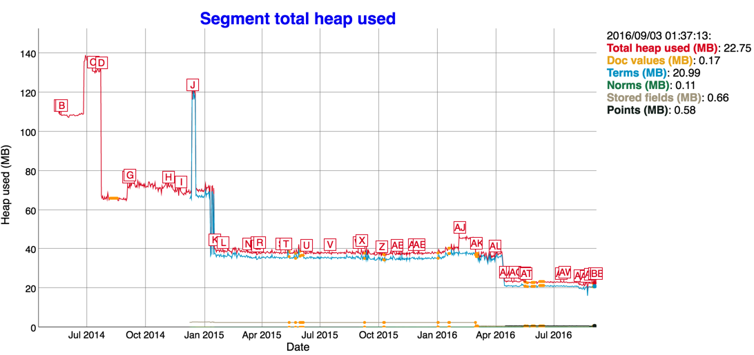
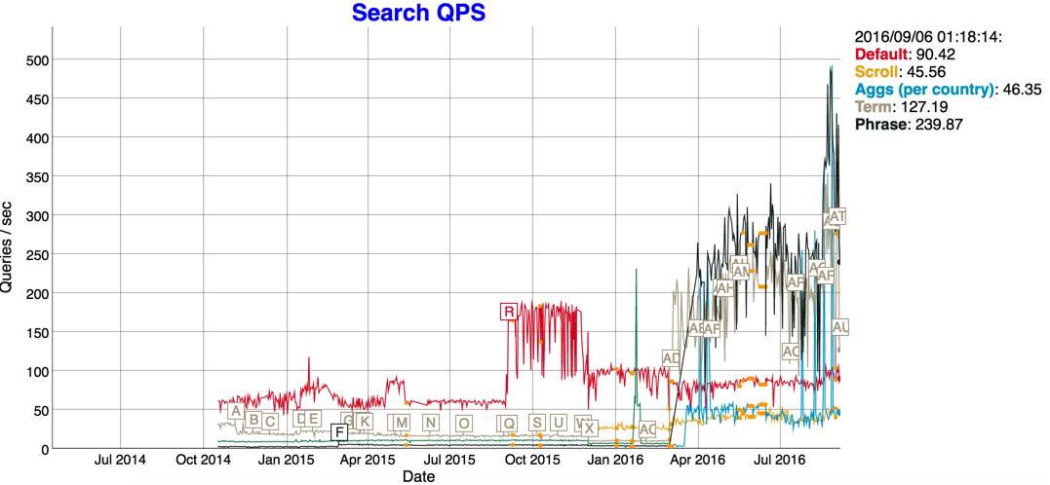

Performance
Lucene 6.x
DimensionalPoints/Multi-dimensionalpoints
numeric, date, and geospatial fields will be:50% disk; 50% index time；75% search time

Slide 15
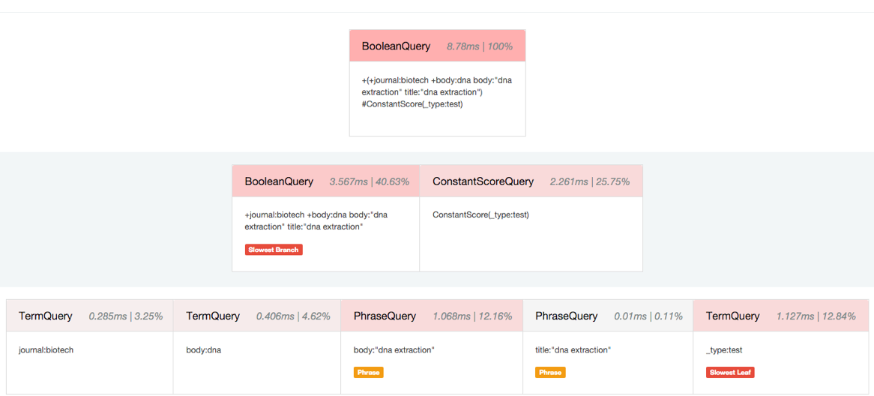
Profile API

Slide 16
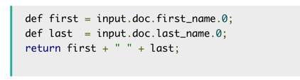
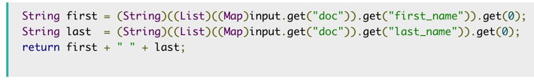
Painless Scripting
Default script language
Fast and secure
Dynamic/ Static
it is ten times faster!

Slide 17
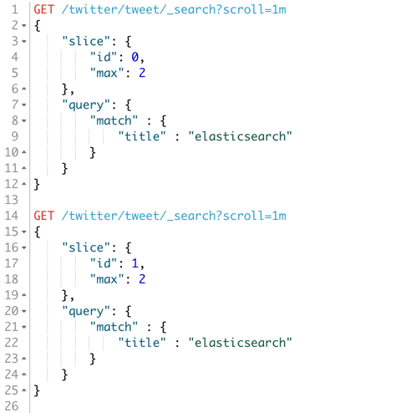
Sliced Scroll
Parallelize your scroll

Slide 18
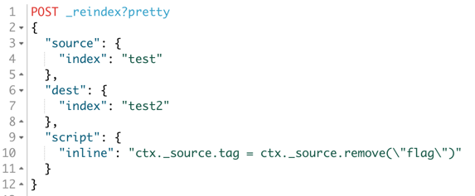
Tasks & Reindex
Task Management API
Manage long running tasks in Elasticsearch
A stepping stone towards future capabilities
Reindex API
The Reindex API makes upgrading Elasticsearch easy
Change problematic mappings & upgrade to the latest / greatest
An important step towards 5.0 and there is a detailed blog post

Slide 19
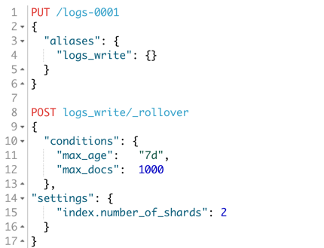
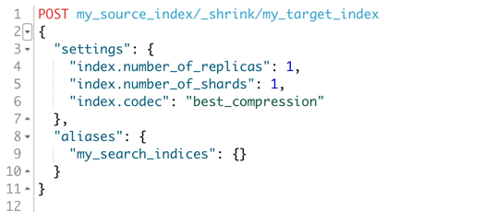
Shrink & Rollover
Shrink API
索引分片收缩
Rollover API
索引自动拆分

Slide 20
What’s more
Ingest Node
Java Rest Client
Text/Keyword to Replace Strings
Instant aggregations
Date queries(aggregations) now cacheable
Search After （deep paging）
Wait for refresh （document level refresh）
Settings Validation & Safety in production
IndexName -> UUID
Depreated logging
HDFS Snapshot/Restore / Delete-by-query / Update-by-query move to core
BM25
Notes:
Settings Validation
How many hours have you lost to a settings typo which was just silently ignored? No more! Almost all settings are now strictly validated, either when starting a node, or when updating a dynamic cluster or index setting. Setting updates are now atomic: if one setting is invalid, the whole request will be rejected, so you won’t be left in an impossible situation where only half your settings have been applied.
The settings rewrite brings two new long-requested features:
Settings can be unset (or reset to the default value) simply by setting them to null.
The default value for all settings can be retrieved by adding ?include_defaults to the GET-settings request.
Safety in production
We have seen many users suffer unexpected problems and even data loss because they have forgotten a simple setting like ensuring enough file handles are available, or giving Elasticsearch permission to mlockall the entire heap into memory. While we log warnings about these issue, not many people look at the logs until after disaster has struck. To make users aware of these problems early on, Elasticsearch should refuse to start.
This is a difficult problem to solve because it interferes with the out-of-the-box experience. Who wants to configure their laptop as if it were a production system before starting to develop on Elasticsearch? We needed to find some way to distinguish between Elasticsearch being used in development mode and in production mode. Since Elasticsearch 2.0.0, nodes bind only to localhost by default. This is fine for development but won’t allow you to form a cluster across multiple servers without configuring the networking.
This is the signal we are using: if network settings use the defaults, we warn about potential problems in the logs. As soon as networking is configured, those warnings are upgraded to exceptions which will prevent Elasticsearch from starting.
Resilience
Besides the more obvious features listed above, there are a host of changes that have gone into this release to make Elasticsearch safer than ever before. Every part of the distributed model has been picked apart, refactored, simplified, and made more reliable. Cluster state updates now wait for acknowledgement from all the nodes in the cluster. When a replica shard is marked as failed by the primary, the primary now waits for a response from the master. Indexes now use their UUID in the data path, instead of the index name, to avoid naming clashes. There are many more incremental improvements like these which mean that your data is safer.

Slide 21
The “Elastic Stack”
User
Interface
Extensions
Store, Index,
& Analyze
Ingest
Notes:
Brand new!

Slide 22






Logstash: Collect from diverse inputs
Logs
Machine Data
Databases
Message Queues
Social
Web APIs
Sensors
Collects diverse sources
Logs + many others
Over 200 plugins
Connects with live streams
Real-Time data
Wire / Transaction data
Full-Packet Network Capture
http://github.com/elastic/logstash

Slide 23
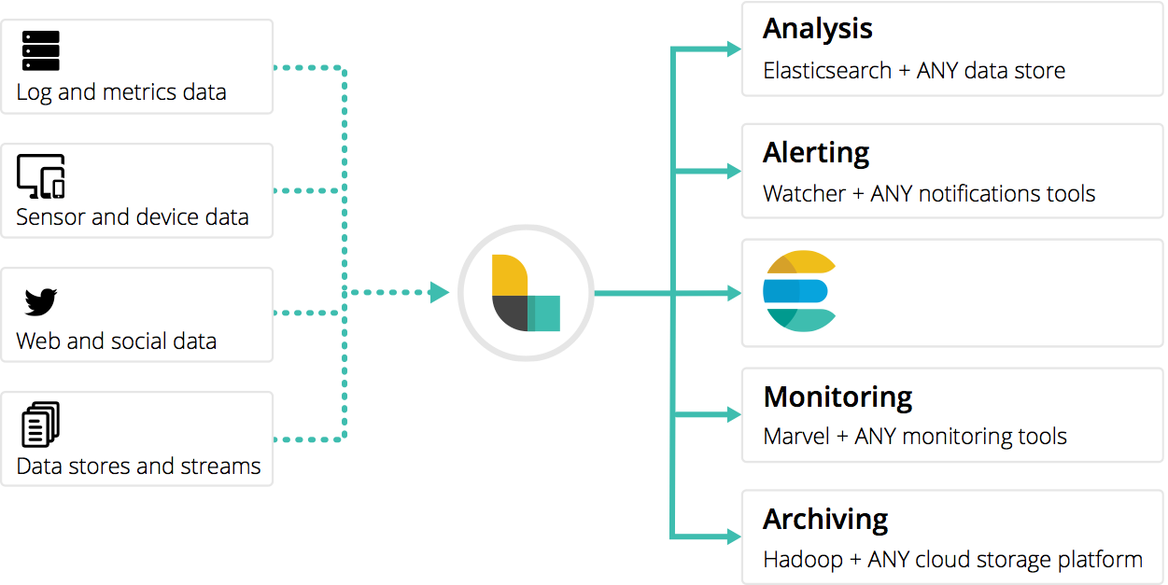
Plugins
Kafka, HDFS,
Salesforce, HTTP,
Oh my!

Slide 24
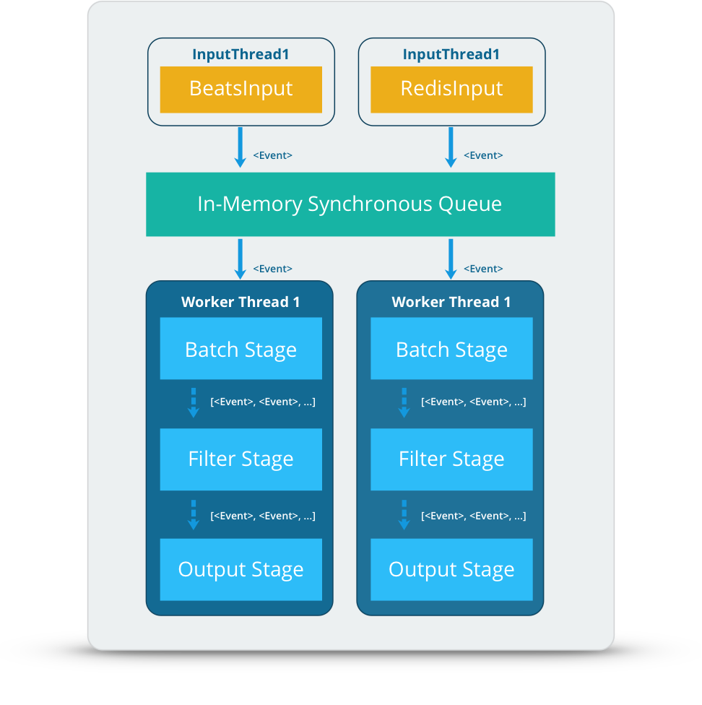
New pipeline Architecture
Faster, more reliable pipeline
Next generation data pipeline;
~30% performance gains
micro-batches,
process groups of events

Slide 25
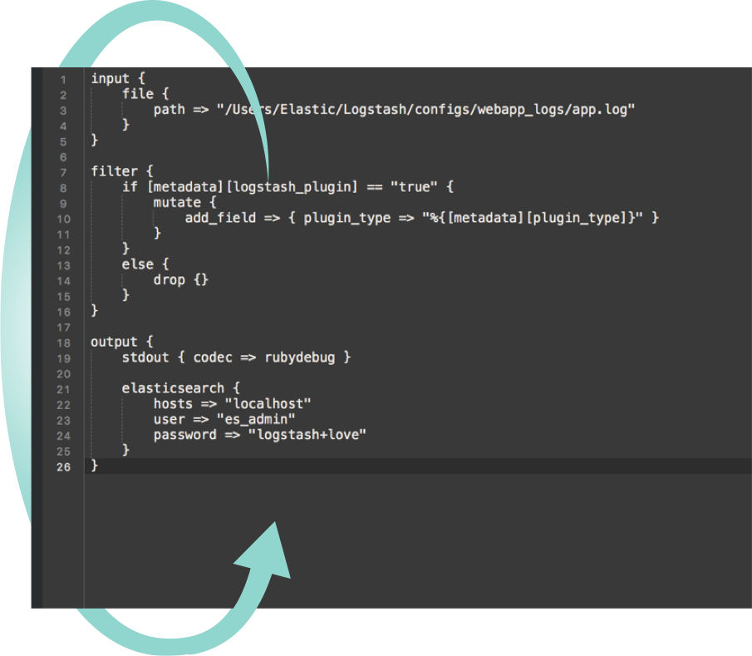
Config Reload
Dynamic
reloading

Slide 26
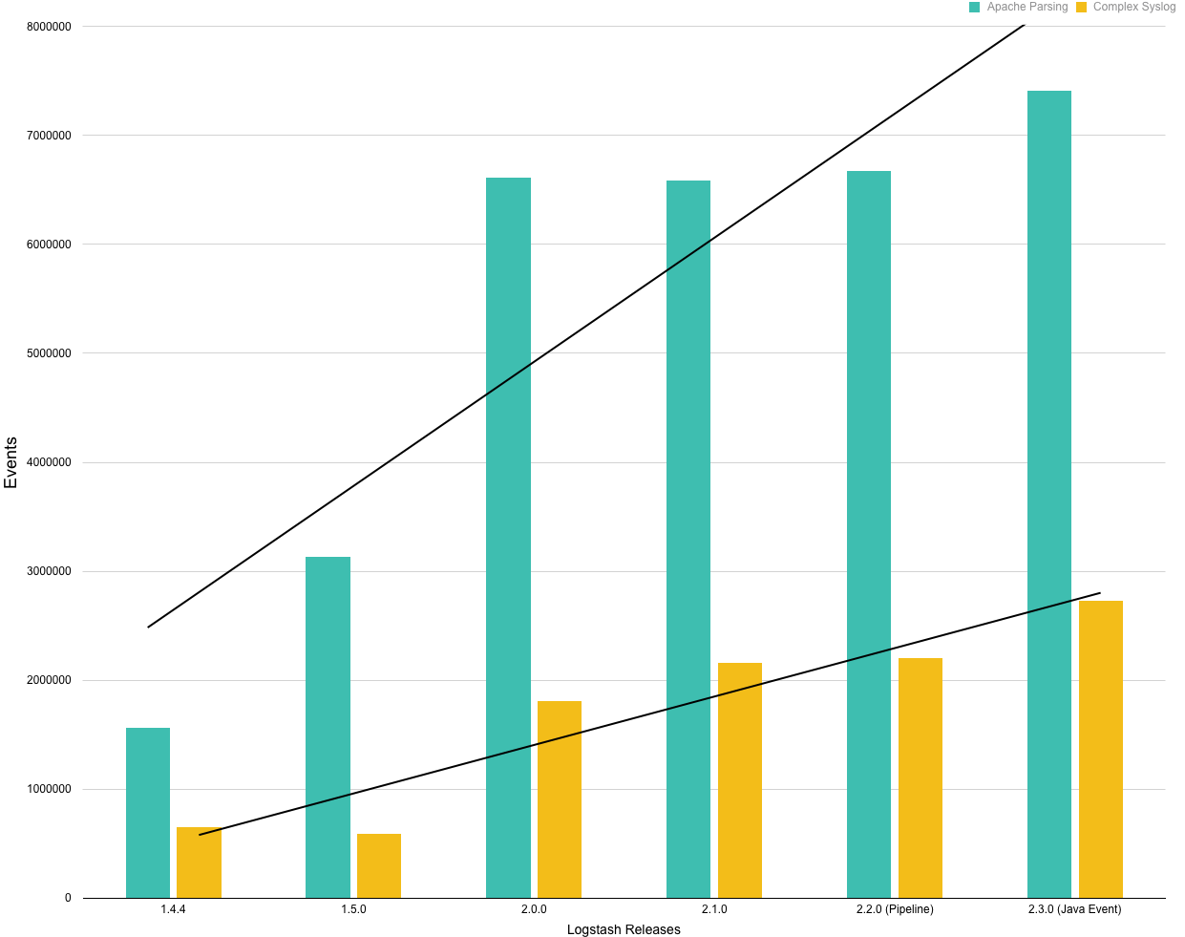
Performance
Now you can
grok faster

Slide 27
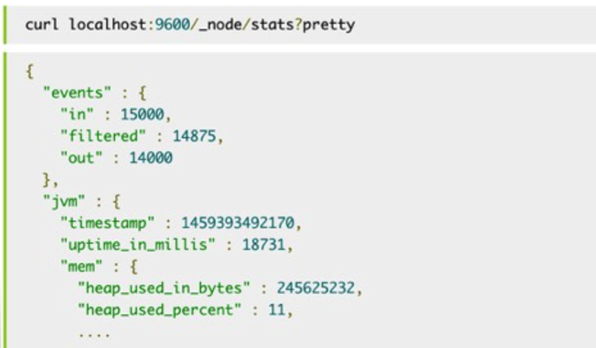
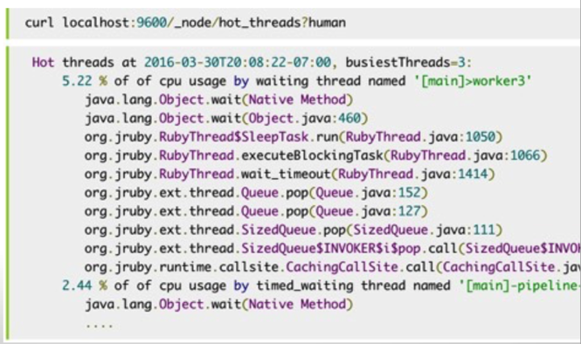
Monitoring API

Slide 28
What’s more
Environment variable injection
Offline plugin installation
Plugin Generator
Java Event API
Kafka0.9/0.10 support
Support SSL encryption and client auth
Persistence queue (disk based)
Monitoring APIs with Marvel integration
Rewriting to native Java

Slide 29
The “Elastic Stack”
User
Interface
Extensions
Store, Index,
& Analyze
Ingest
Notes:
Brand new!

Slide 30



Beats are lightweight shippers that collect and ship all kinds of operational data to Elasticsearch
Small application
Install as agent on your servers
Written in Golang
No runtime dependencies
Single purpose
http://github.com/elastic/beats

Slide 31

Beats: Data Shippers for Elasticsearch
Filebeat: Next-generation Logstash forwarder to collect, pre-process, and forward log files.
Libbeat: Library for forwarding host-based metrics to Elasticsearch
Packetbeat: Real-time network packet analytics for web, database, and any network protocols
Metricbeat: Fetches a set of metrics on a predefined interval from the operating system and services (Apache web server, Redis, and more)
Winlogbeat: System, application, and security information from Window event logs
Topbeat: Gather resource utilization data such as CPU, memory, and other pre-process/system data
Notes:
Keep
Relatively new
Lightweight application
Written in Golang
Install as agent on your servers
No runtime dependencies
Single purpose

Slide 32
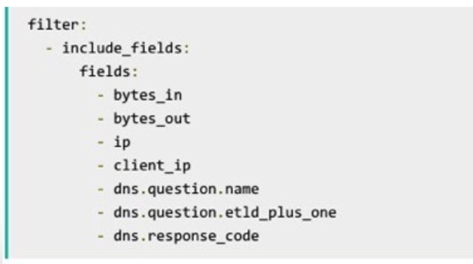
Custom Fields and generic filtering
Filtering the exported data

Slide 33
Filebeat
Decode JSON from log lines
Multiline support
Kafka output
Output to Kafka directly
• Integration with Ingest Node
Set “pipeline parameter” in the Elasticsearch output config

Slide 34
Packetbeat
Cassandra protocol
Support IP/TCP flows
Report statistics like packet/byte counts
More prebuilt dashboards
Template loading

Slide 35
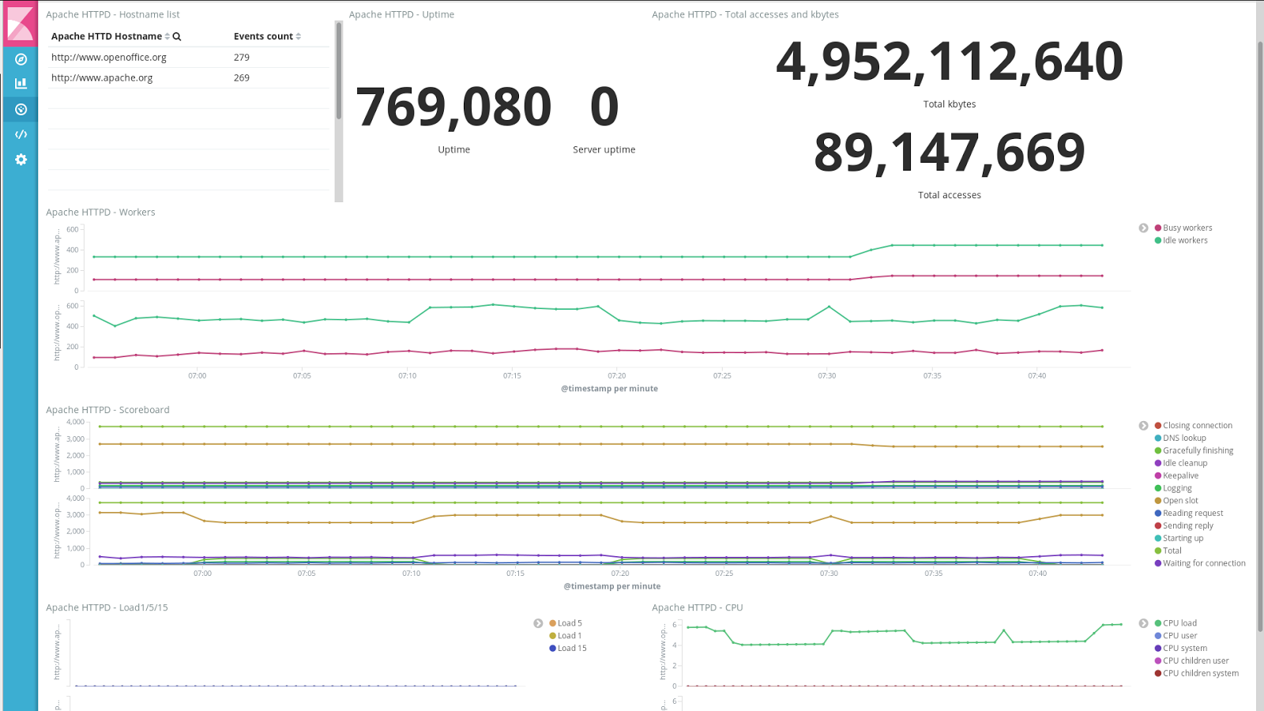
Metricbeat
mongoDB
apache
mysql
nginx
postgresql
redis
system
zookeeper

Slide 36
The “Elastic Stack”
User
Interface
Extensions
Store, Index,
& Analyze
Ingest
Notes:
Brand new!

Slide 37

What’s Kibana？
Kibana is an
open source analytics
and visualization platform
designed to work with Elasticsearch.
http://github.com/elastic/kibana

Slide 38
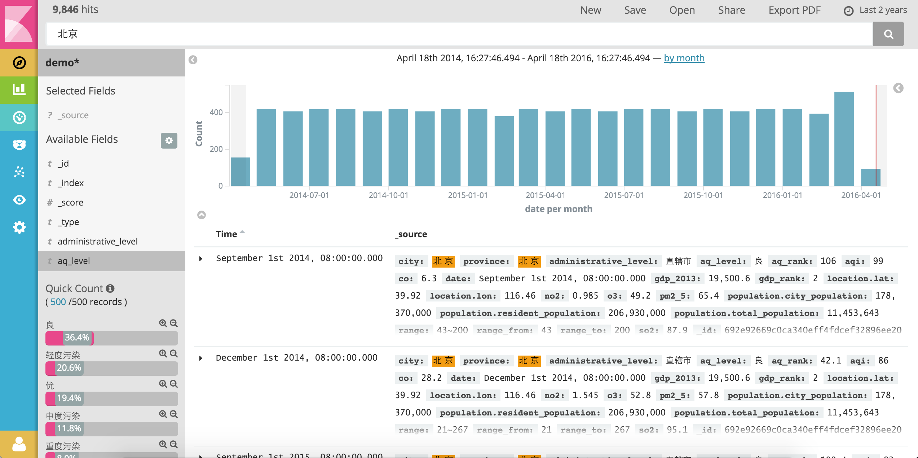
New design

Slide 39
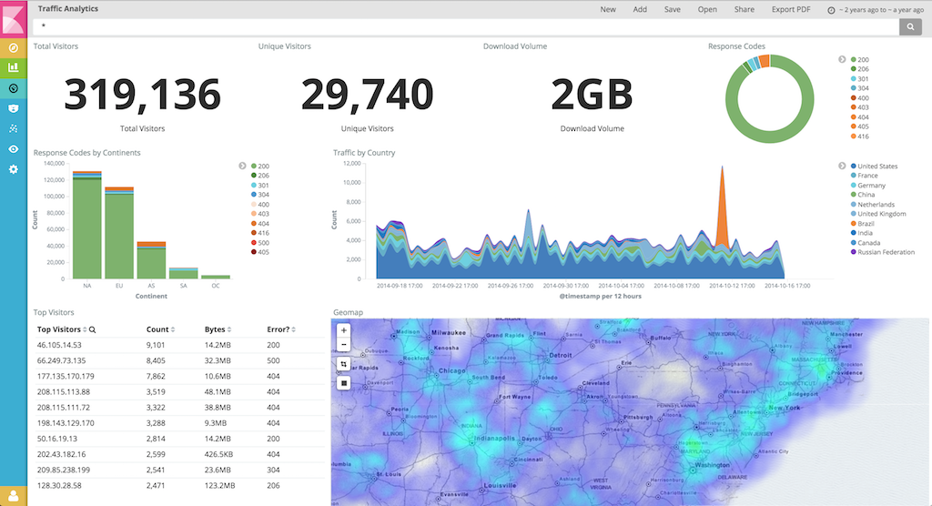
Brings a new focus on your data

Slide 40
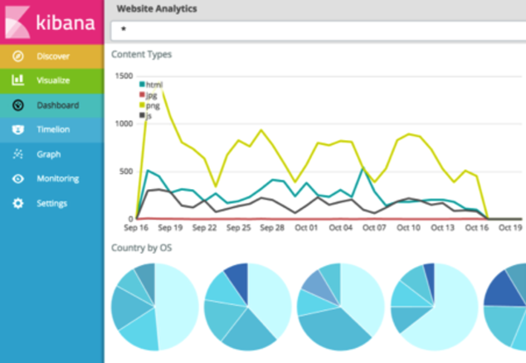
Applicaton Framework
^{Appear in the main navigation}

Slide 41
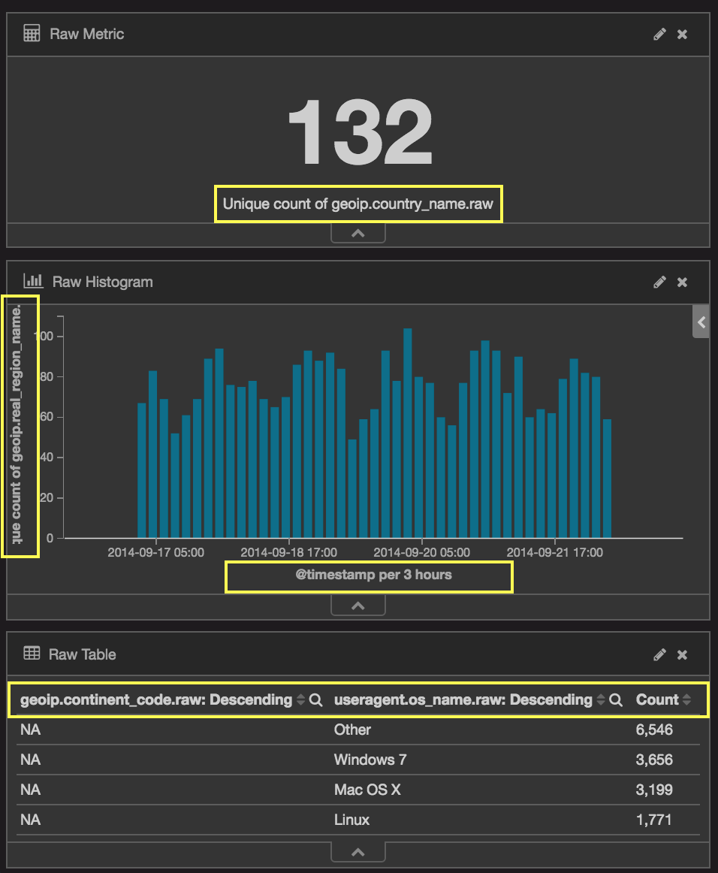
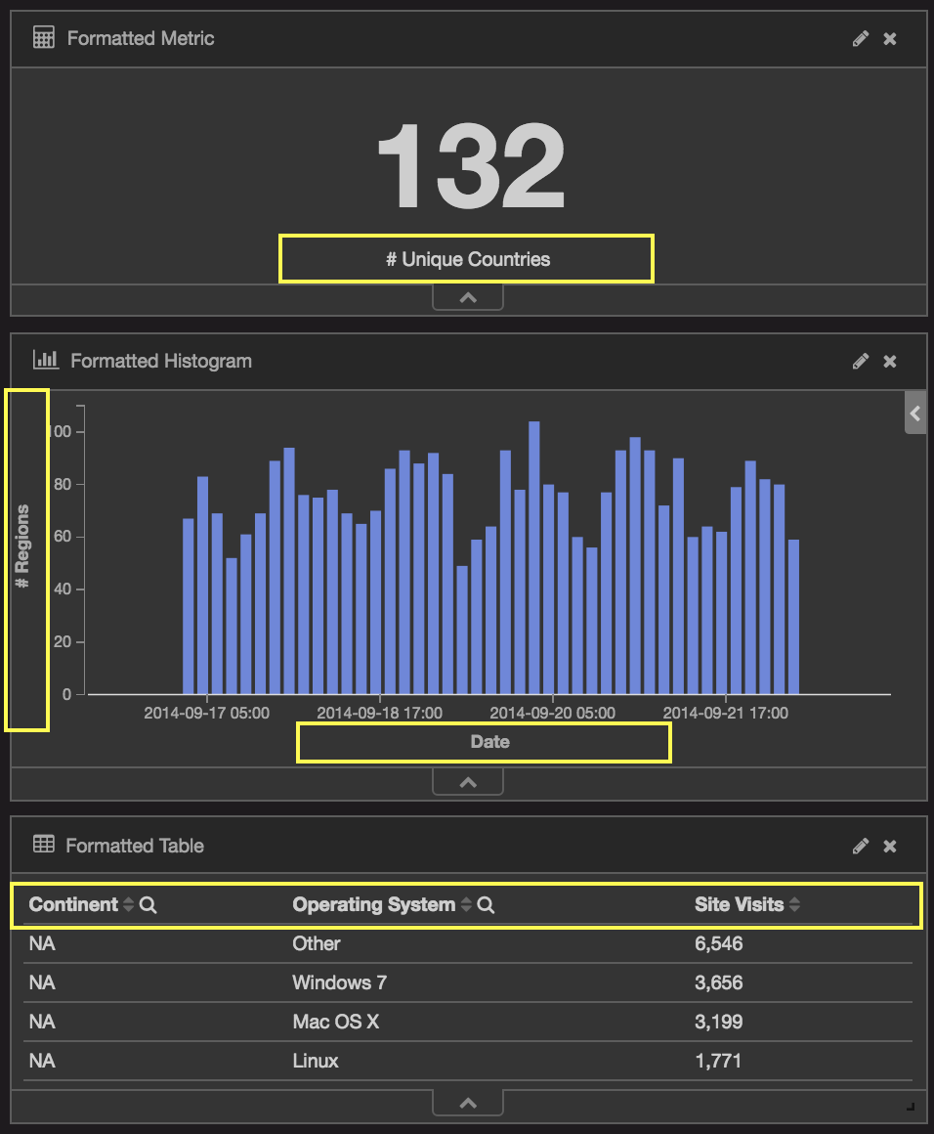
System-Generated Labels
Custom Labels

Slide 42
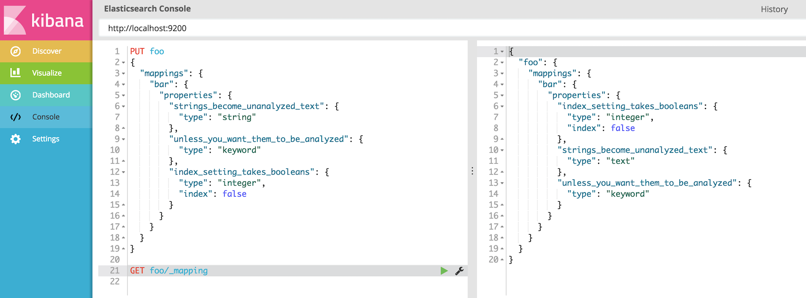
Console

Slide 43
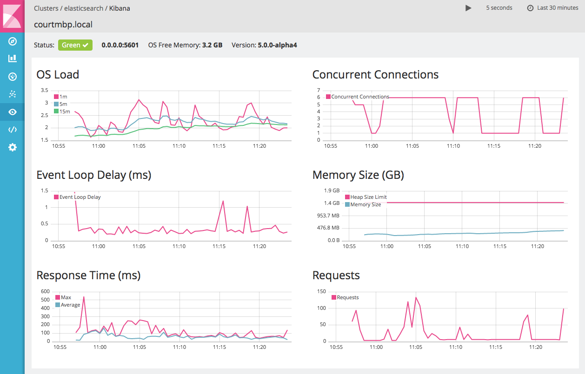
Marvel

Slide 44
What’s more
Tile Service
Timelion
Graph
Reporting

Slide 45
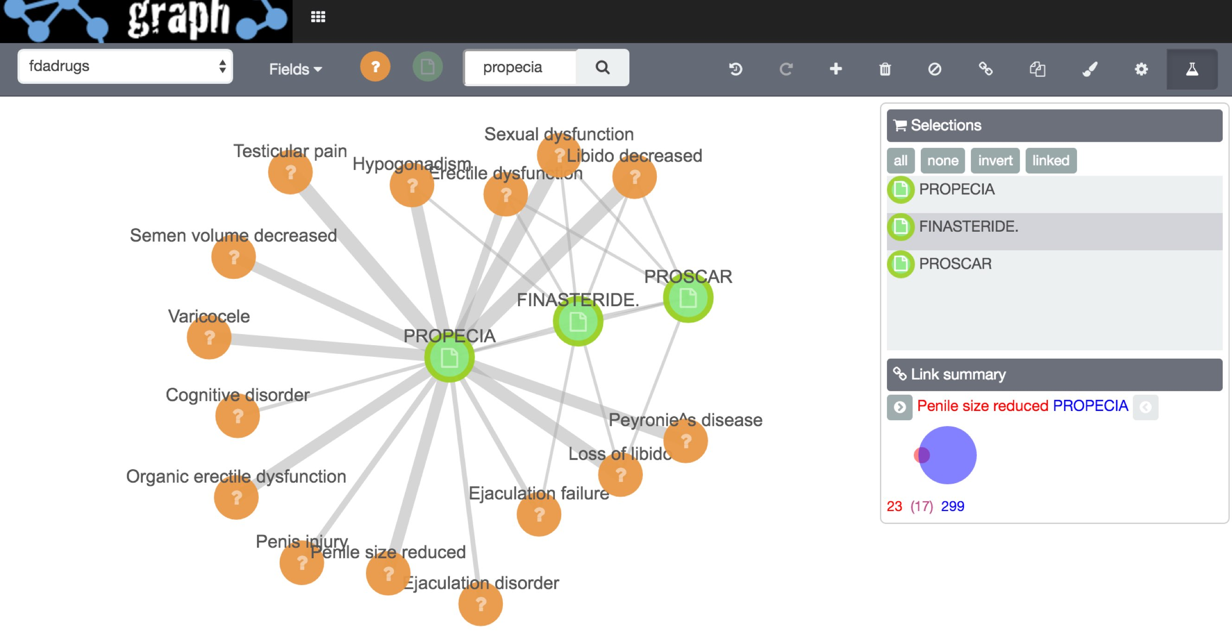

Slide 46

Community
文档 & 服务 https://www.elastic.co/
源码 & Issue: http://github.com/elastic/
中文社区: http://elasticsearch.cn/
Elastic{ON} Dev China 2016 来了!
http://conf.elasticsearch.cn

Slide 47
Thanks!

